Slide 1
IDAC Qtr. 2
January 18, 2024

Slide 2
Intercultural Diversity Advisory Council
Gettysburg Goals:
Increase Multicultural Education
Acceptance and understanding of All
We know that creating an environment where students feel accepted will have a direct impact on student achievement.

Slide 3
Action Plan
Multicultural Education
Student engagement through a monthly focus.
October - Hispanic Heritage Month
November - Indian Heritage Month
February - Black History Month
March - Irish Heritage Month
April - Autism Awareness Month / Disability Awareness
May - Multicultural Fashion Show - Cultural Profile (Block G point)

Slide 4
23-24 Hispanic Heritage Month
Book walks in the amphitheatre
Students learned about Dia De Los Muertos
Students had the opportunity to create an offrenda to honor a family member or a family pet that they would like to remember.
Students were designated to present to their peers at lunch time to share their family traditions.
Parent volunteers and CHS students from the Folklorico team performed for our students at lunch.

Slide 5
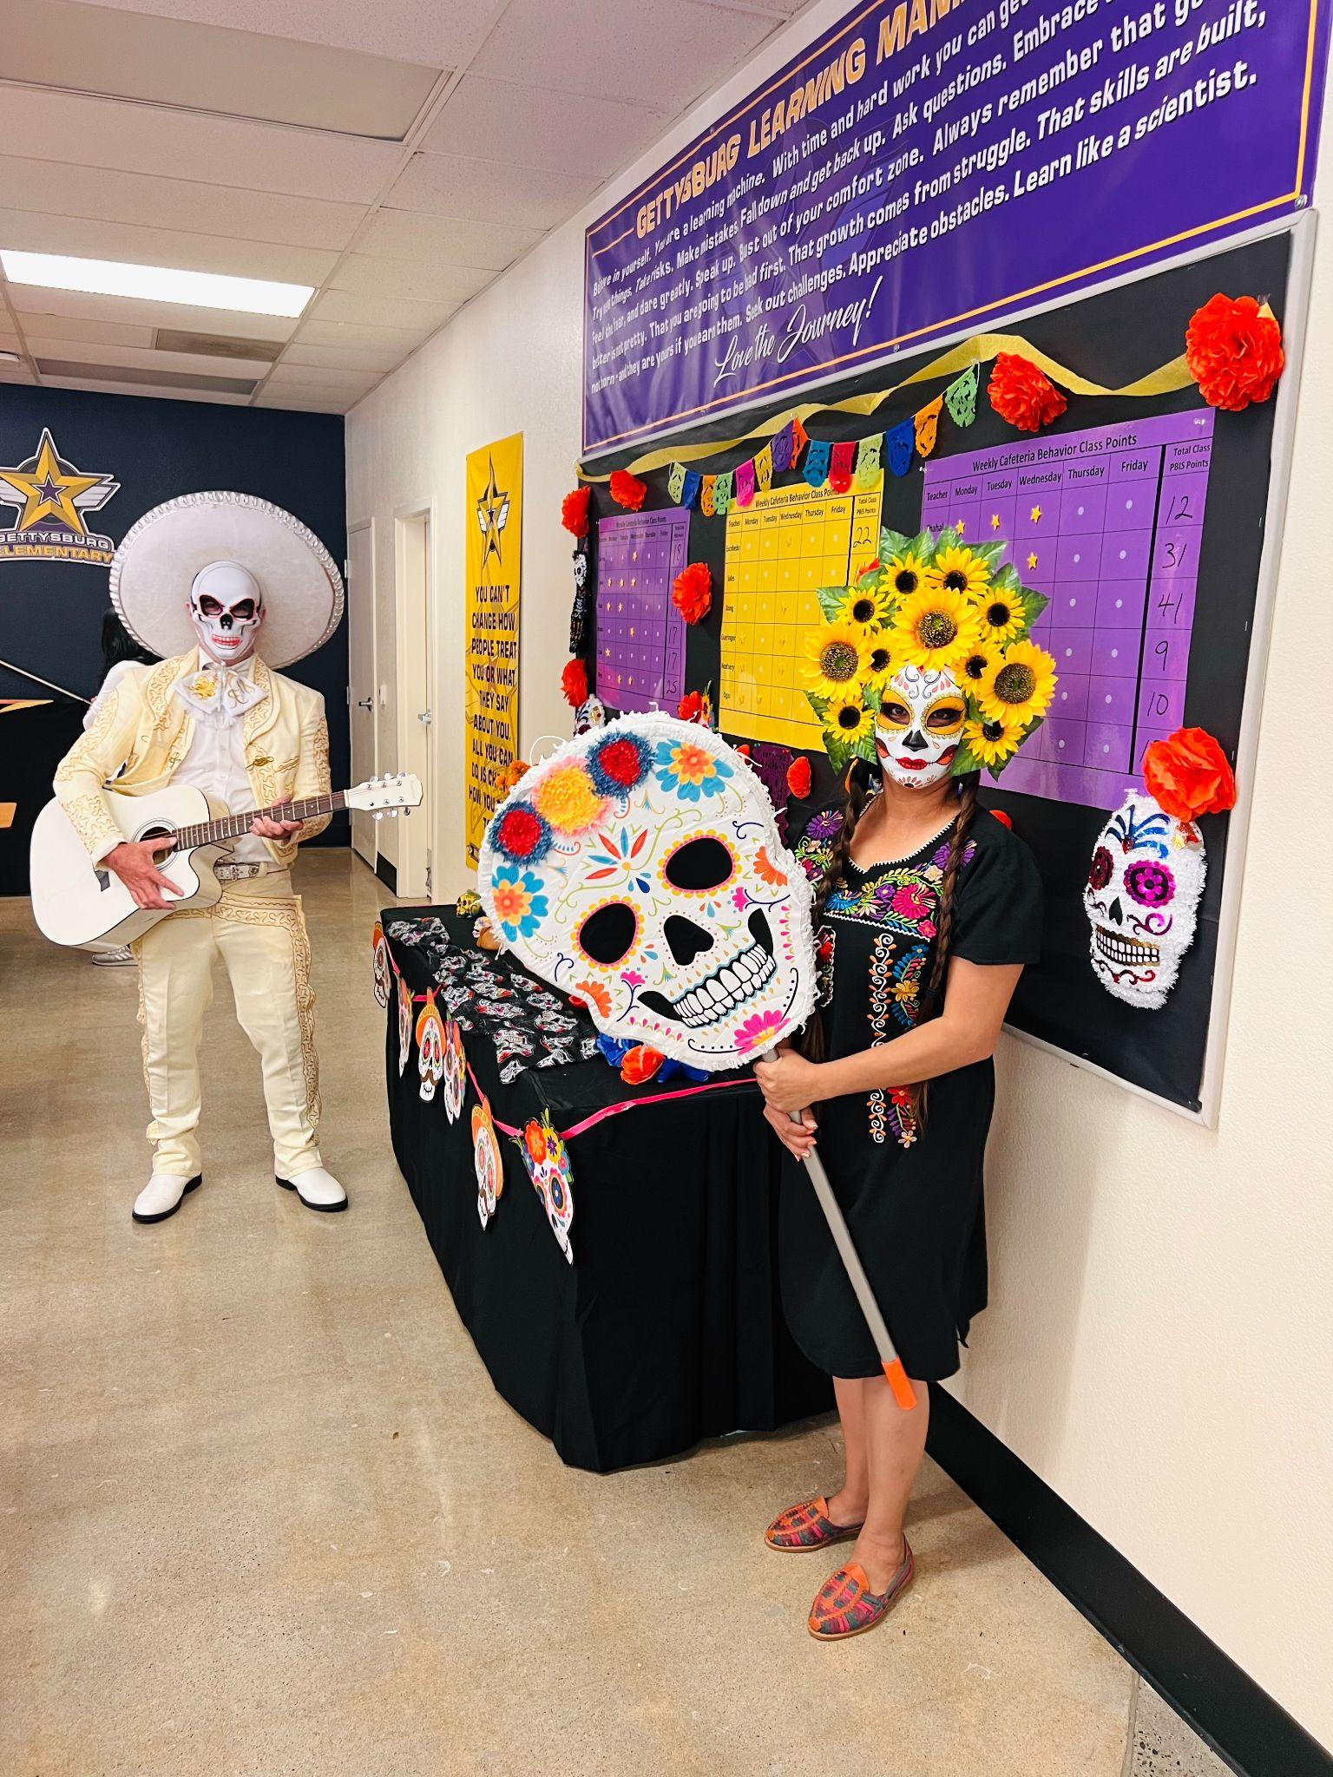
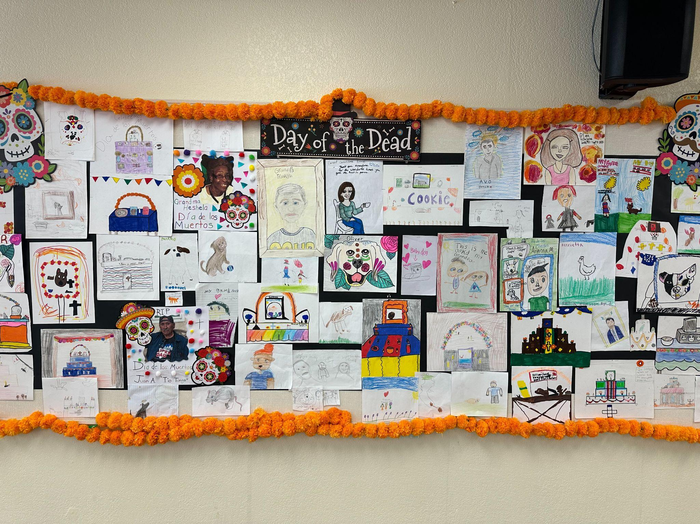
Hispanic Heritage Month

Slide 6
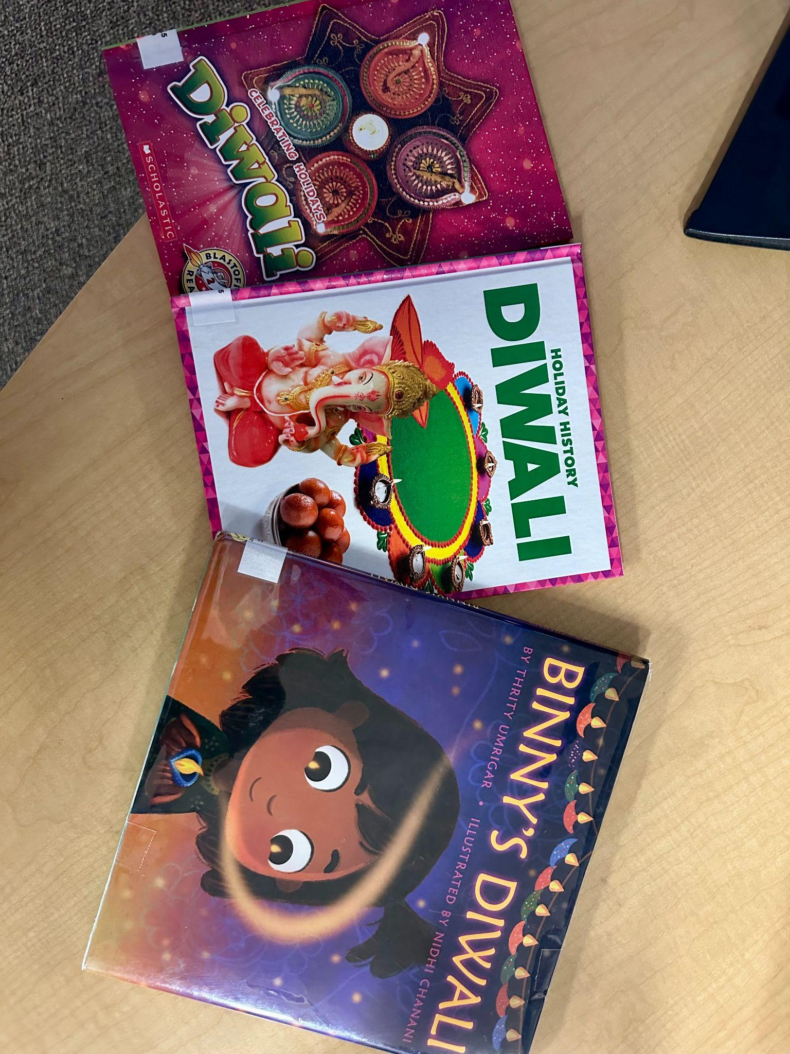
Indian Heritage Month
Diwali Book Walk
Books read in the Library
Next year’s goal…student presentation/dance to learn the significance of Diwali.

Slide 7
Principal's Advisory Council PAC
The PAC will be formed 2nd semester.
This group is comprised of a diverse group of students who are collaborative, good listeners, and have leadership abilities. They will meet with the principal once per quarter, or more as needed, to discuss school climate and activities to promote positivity. All PAC representatives will be expected to give a report to their classes about what was discussed in each meeting.

